Slide 1
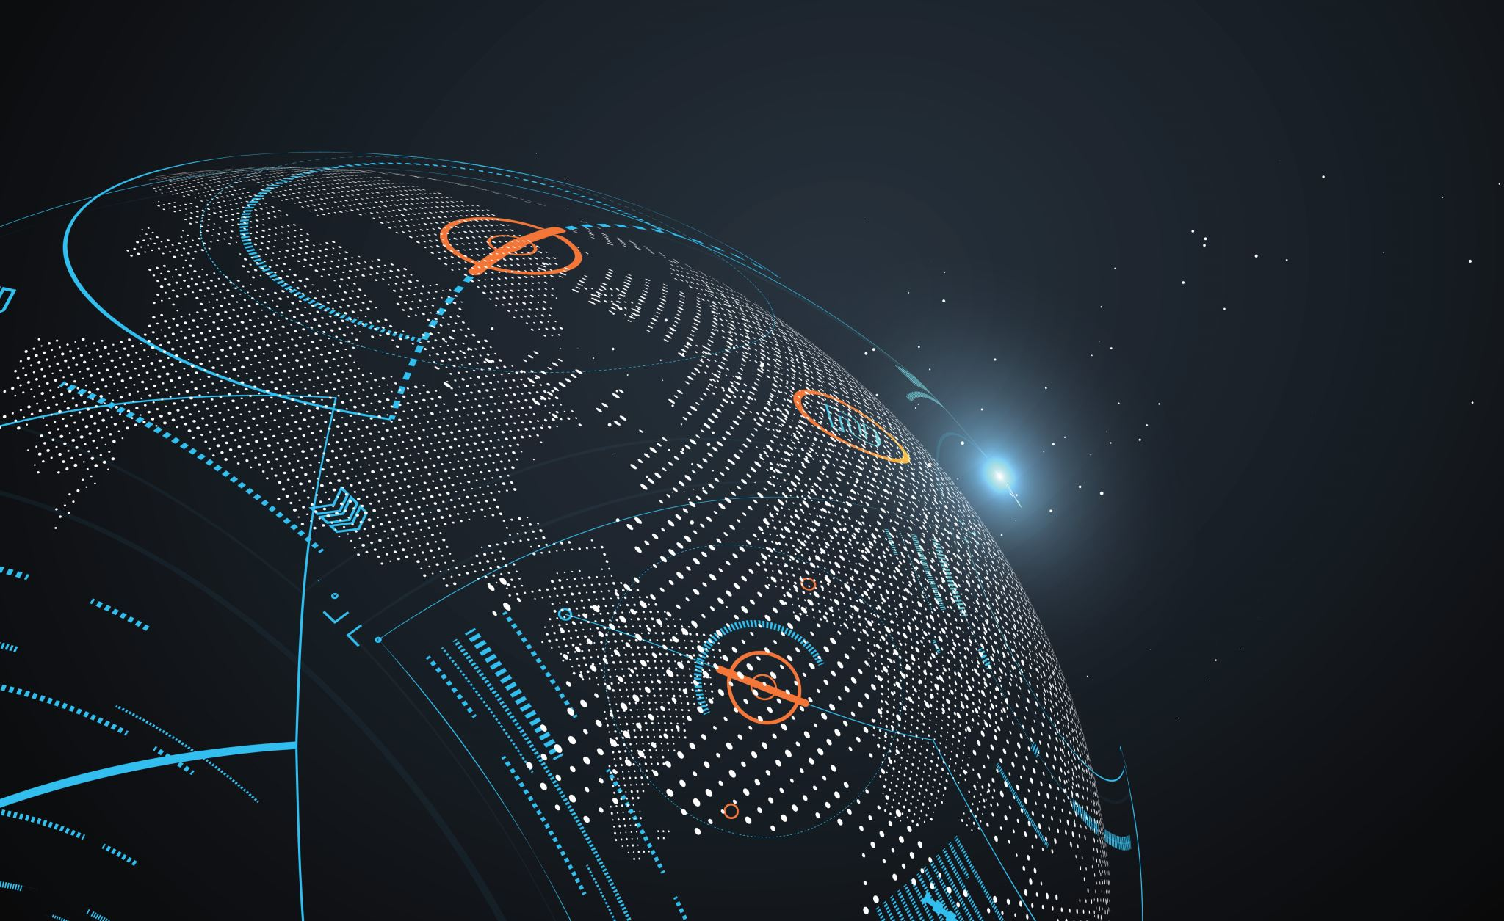
INTERNET OF THINGS (IOT) APPLICATIONS
BY
SYED MUHAMMAD MOOAZAM

Slide 2
IoT in different sectors
Industrial and Manufacturing
Consumer
Retail, financial, and marketing
Healthcare
Transportation and logistics
Agricultural and environmental
Energy
Smart city
Government and military

Slide 3
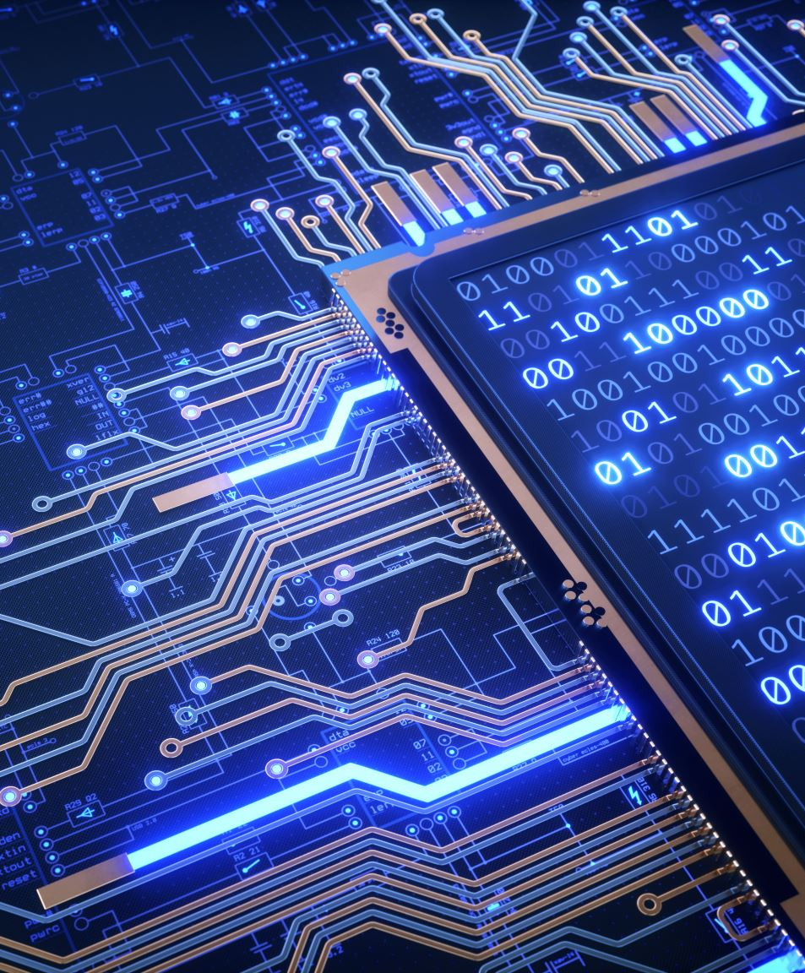
IoT Example: The Refrigerator
A refrigerator is just a thing, so it can be anything besides a computer.
If it's a computer, we're not calling that a thing, but anything besides a computer.
Now the next thing you do is you add to that some type of computational intelligence (Micro controller).
So that's intelligent refrigerator. But maybe you wouldn't call that Internet of Things, because it's not actually networked yet. Then, to top it off, you add Internet connectivity.
It's got some kind of computation inside and it's got a network connection which means it can use all sorts of other resources that are not local.

Slide 4
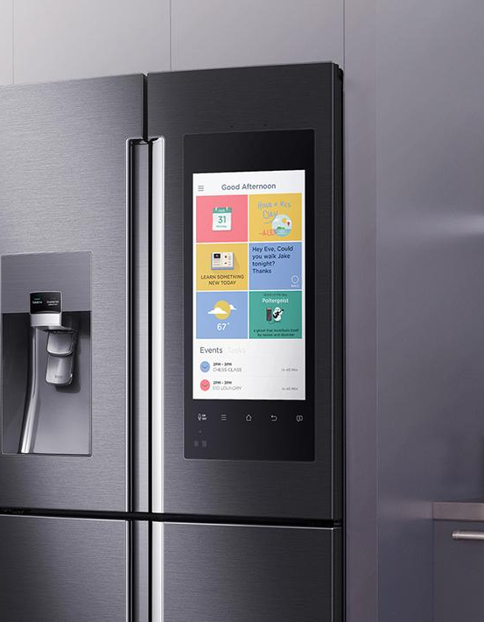
IoT Example: What the IoT Refrigerator can do
You can have IoT fridge detect that you are low on butter and then just order that, and then the next morning, butter will appear on your doorstep.
You can search for low food prices.
Give you a good idea for food for you tomorrow for the meal.
IoT device should have a simple interface, have computational intelligence and be connected to the internet.

Slide 5
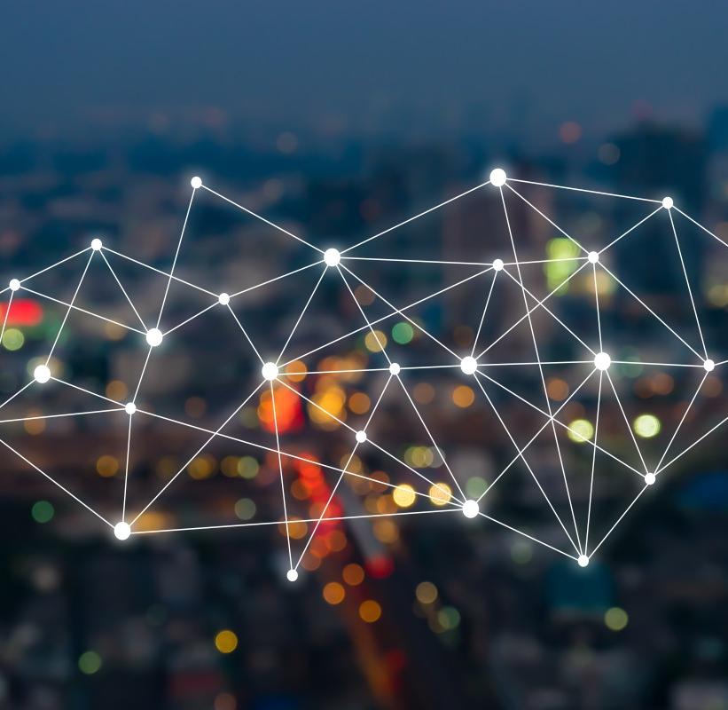
IoT for Manufacturing
Microsoft highlights the following benefits for implementing IoT solutions in a manufacturing scenario
Improved visibility across your manufacturing operations—make more informed decisions with a real-time picture of operational status.
Improved utilization—maximize asset performance and uptime with the visibility required for central monitoring and management.
Reduced waste—take faster action to reduce or prevent certain forms of waste.
Improved quality—detect and prevent quality problems by finding and addressing equipment issues sooner.

Slide 6
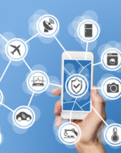
Consumer IoT use cases
Smart home gadgetry: Smart irrigation, smart garage doors, smart locks, smart lights, smart thermostats, and smart security.
Wearables: Health and movement trackers, smart clothing/wearables.
Pets: Pet location systems, smart dog doors.

Slide 7
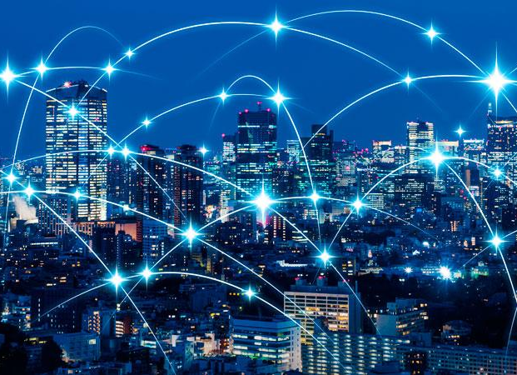
IoT enabled Smart City
Enhanced citizen safety
Optimized public services
Economic growth
Improved traffic flow
Improved environment

Slide 8



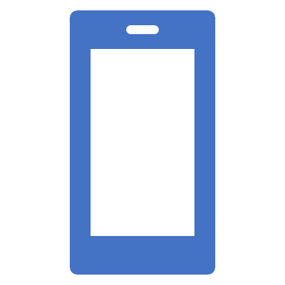
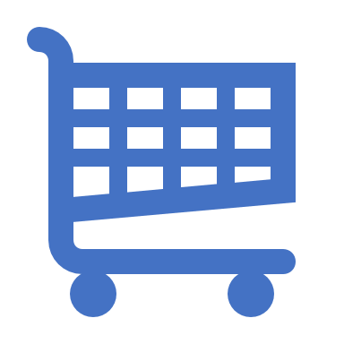
IoT enabled Retail
Predictive Equipment Maintenance
Smart Transportation
Data-aware Warehouses
Connected Consumer
Smart Store

Slide 9
Healthcare IoT use cases
In-home patient care
Hospital equipment and supply asset tracking
Pharmaceutical tracking and security
Remote field medicine
Drug research
Patient fall indicators

Slide 10
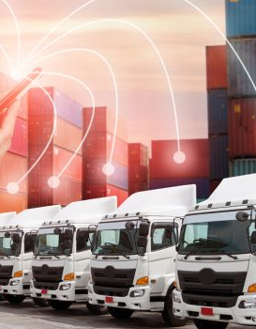
Transportation and logistics IoT use cases
Fleet tracking and location awareness.
Asset and package tracking within fleets.
Preventative maintenance of vehicles on the road.

Slide 11
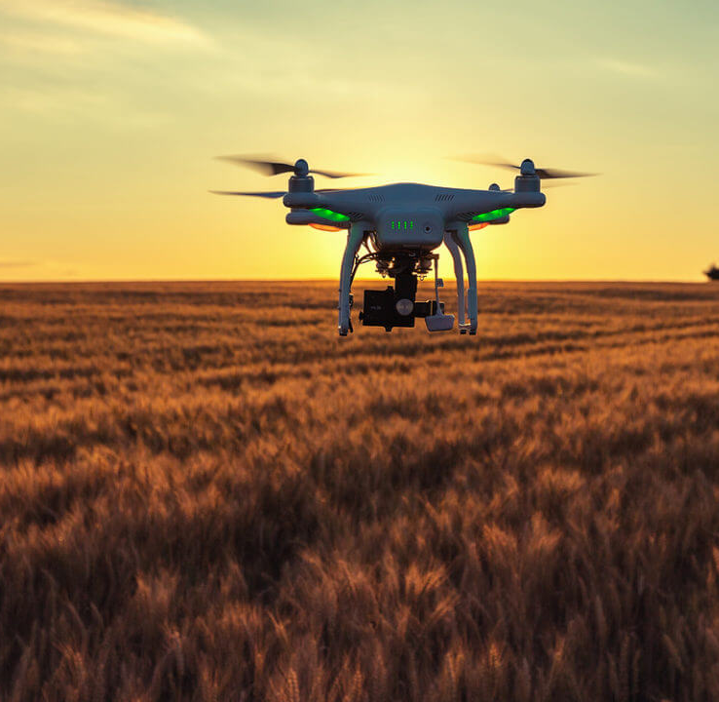
Agricultural and environmental IoT use cases
Smart irrigation and fertilization techniques to improve yield.
Smart lighting in nesting or poultry farming to improve yield.
Livestock health and asset tracking.
Drones-based land surveys.
Robotic farming.
Volcanic and fault line monitoring for predictive disasters.

Slide 12
Energy IoT use cases
Oil rig analysis of thousands of sensors and data points for efficiency gains.
Remote solar panel monitoring and maintenance.
Smart electric meters in a citywide deployment to monitor energy usage and demand.

Slide 13
Government and Military IoT use cases
Terror threat analysis through IoT device.
Sensor bombs deployed on the battlefield to form sensor networks to monitor threats.
Government asset tracking systems.
Real-time military personal tracking and location services.
Synthetic sensors to monitor hostile environments.
Water level monitoring to measure dam and flood containment.

Slide 14
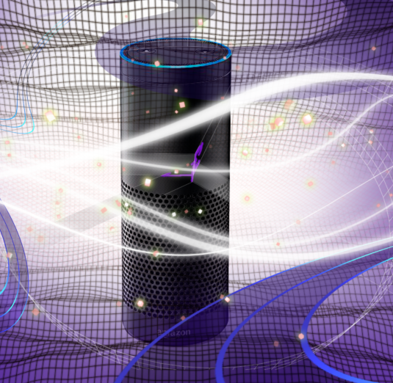
Voice control
Home automation
Automobiles
Health Care
Entertainment

Slide 15
muhammadmoazam29@gmail.com
https://www.linkedin.com/in/mooazam/
FOR
CONTACT

Slide 16
THANK YOU

